Slide 1
Cecil County Public Schools Bookworms K–5 Reading and Writing Case Study Data

Slide 2
About Cecil County Public Schools
Student Population:
- 15,859 students (2015-16 NCES)
17 elementary schools
44% of students qualify for free/reduced lunch (2017-18, MD State)

Slide 3
PARCC Proficiency Post-Bookworms: Years 1 and 2
Grades | 2015 Year 1, PARCC Assessment | 2016 Pre-Bookworms | 2017 Year 1, Bookworms Implementation | 2018 Year 2, Bookworms Implementation | Change in Proficiency, 2016-18 | Change in Proficiency, 2015-18
Grade 3 | 30.1% | 30.5% | 35.1% | 36.1% | +5.6% | +6%
Grade 4 | 33.5% | 30.4% | 38.0% | 43.8% | +13.4% | +10.3%
Grade 5 | 29.4% | 31.3% | 40.1% | 42.3% | +11% | +12.9%
Gr. 3-5 | 31% | 30.8% | 37.7% | 40.8% | +10% | +9.8%

Slide 4
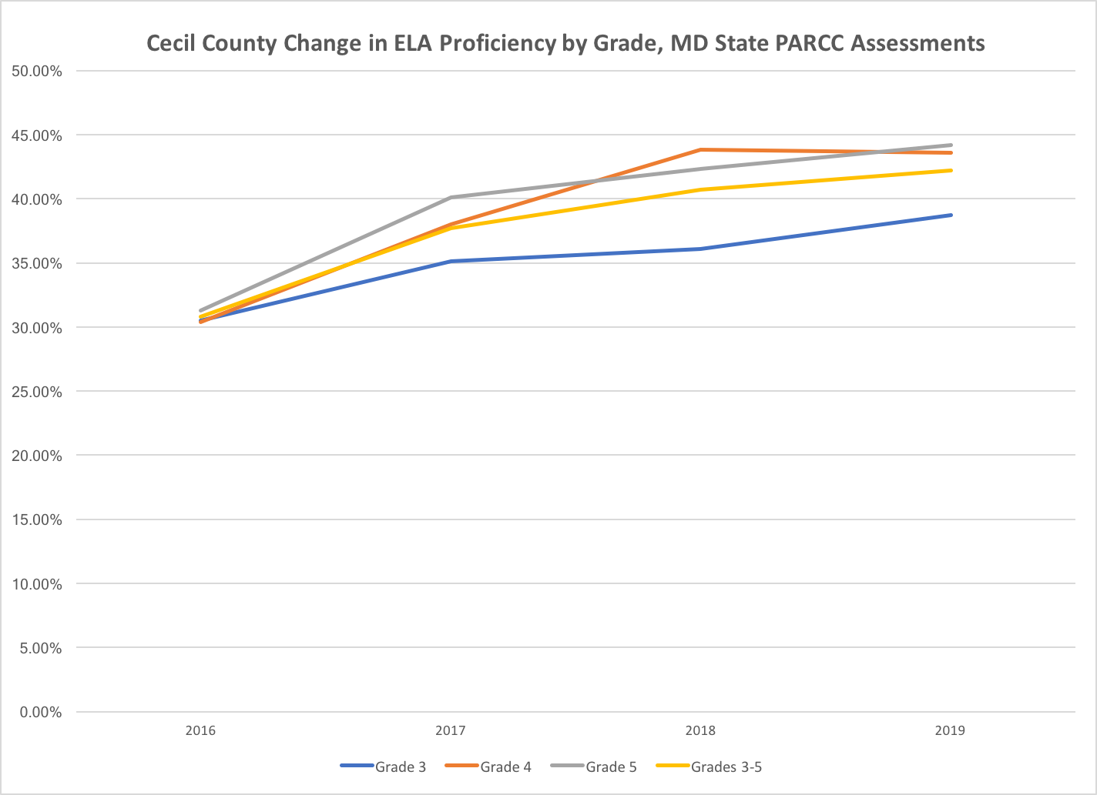
PARCC Proficiency, 2016 through 2019

Slide 5
PARCC Proficiency, 2016 through 2019 by Subgroup
Proficiency by Grade
Grade | 2016 | 2017 | 2018 |  | 2019 | Change in % Proficient
 |  |  |  |  |  | 2016-2019
Grade 3 | 30.5% | 35.1% | 36.1% |  | 38.7% | 8.2
Grade 4 | 30.4% | 38.0% | 43.8% |  | 43.6% | 13.2
Grade 5 | 31.3% | 40.1% | 42.3% |  | 44.2% | 12.9
Grades 3-5 | 30.8% | 37.7% | 40.7% |  | 42.2% | 11.4
Proficiency by Subgroups, Grades 3-5
Subgroup | 2016 | 2017 |  | 2018 | 2019 | Change, 2016-19
African American | 17.8% | 20.4% |  | 25.7% | 26.9% | 9.1
Hispanic | 19.4% | 25.7% |  | 32.5% | 28.8% | 9.4
Special Ed | 4.1% | 4.3% |  | 7.5% | 5.4% | 1.3
ELL | 3.4% | 0.0% |  | 8.8% | 6.5% | 3.1
FARMS | 19.3% | 24.5% |  | 27.0% | 26.7% | 7.4
Female | 37.1% | 43.5% |  | 48.4% | 49.6% | 12.5
Male | 25.3% | 32.6% |  | 34.1% | 35.8% | 10.5

Slide 6
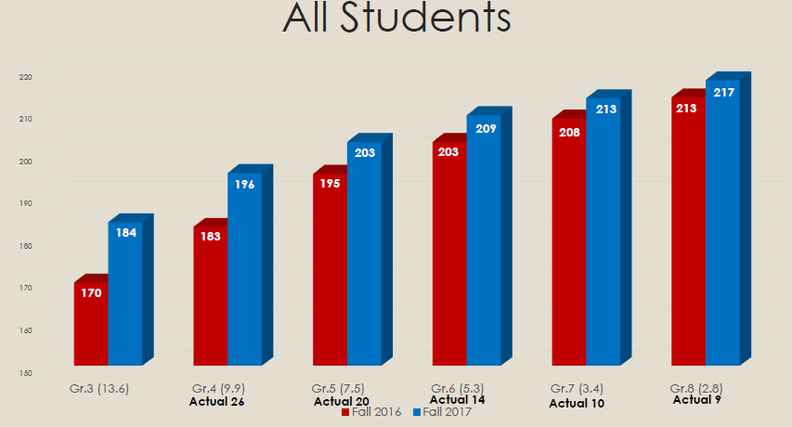
Year 1 MAP Data (Regional Testing)

Slide 7
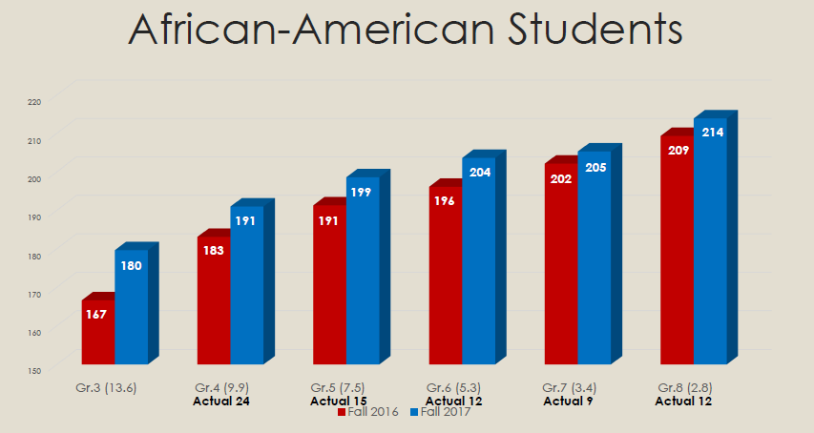
Year 1 MAP Data

Slide 8
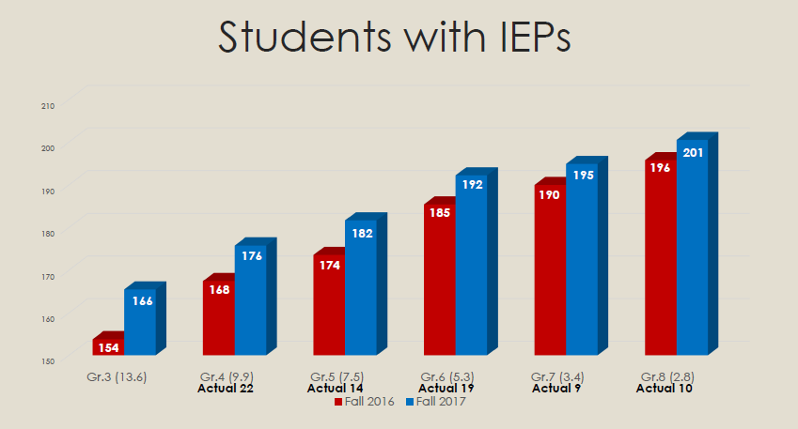
Year 1 MAP Data

Slide 9
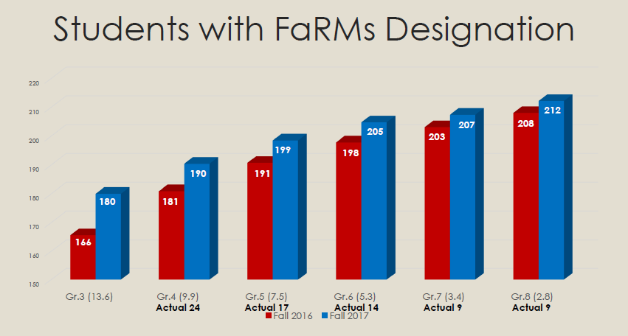
Year 1 MAP Data

Slide 10
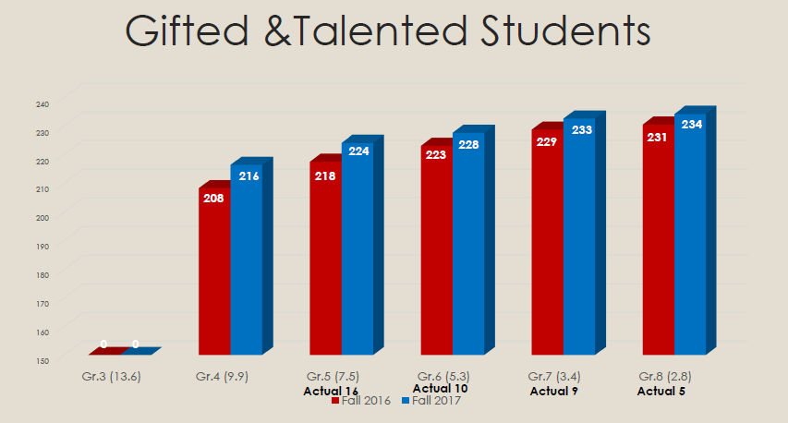
Year 1 MAP Data

Slide 11
Year 1 MAP Data

